Slide 1
Chapter 5: Biotechnology and genetic techniques

Slide 2
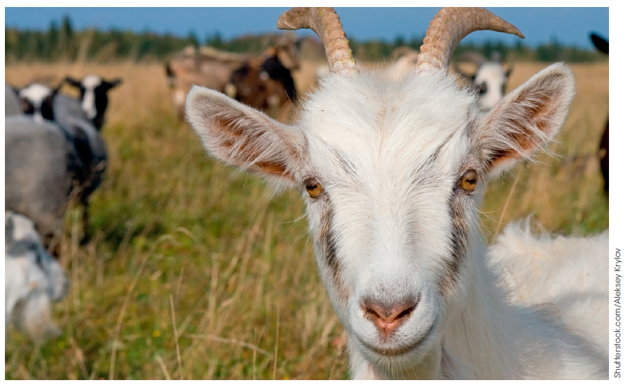
Biotechnology
Biotechnology is the use of living things to make new products or systems.
Figure 5.1
Early examples include domestication and the use of microorganisms to produce bread, beer, wine and cheese.

Slide 3
Genetic engineering
Genetic engineering involves changing the genetic sequence of an organism through the use of modern biotechnology techniques.
Genetically engineered organisms are also called genetically modified organisms (GMOs) or transgenic organisms.

Slide 4
Genetic engineering techniques
Requirements for modification of DNA:
You must be able to make enough copies of DNA to work with.
  or else there are not enough to work with and you’ll run out
You must be able to extract and purify DNA.
  or else parts of cells will interfere with the process
You must be able to cut DNA exactly where you want.
  or else you can’t have specific engineering of DNA sequences
You must be able to insert a piece of DNA exactly where you want into another piece of DNA (this is called recombination).
  or else the inserted DNA or the receiving DNA may not work properly
You must be able to identify successful recombination events.
  or else you may waste a lot of effort and money
You must be able to read the sequence of DNA.
  so that you can check the right modifications have been made
Scientists have biotechnology tools and techniques for all of these processes.

Slide 5
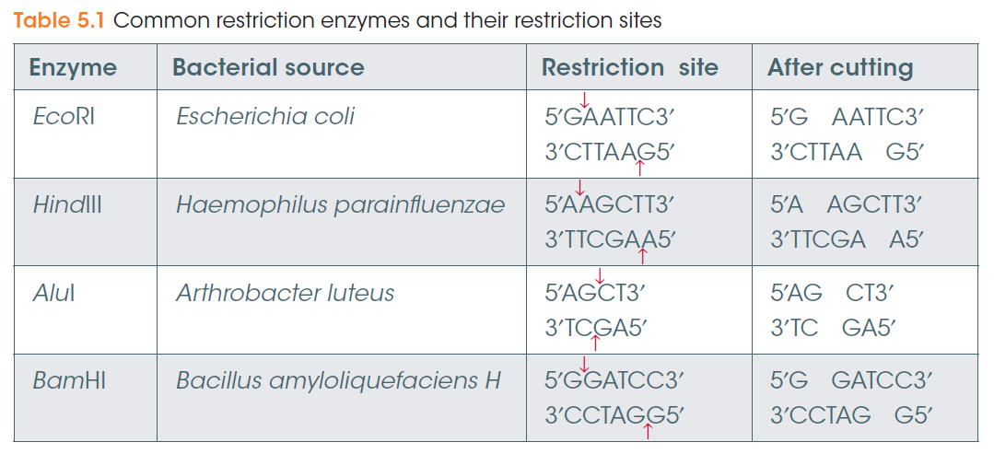
Cutting DNA
Genetic engineering techniques
Enzymes from bacteria can cut DNA at specific sites.
These enzymes are called restriction endonucleases
(endo = within, nuclease = cuts DNA).
They each have a different sequence they recognise and cut.
These are called restriction sites or recognition sites.
Cut DNA pieces are called restriction fragments.

Slide 6
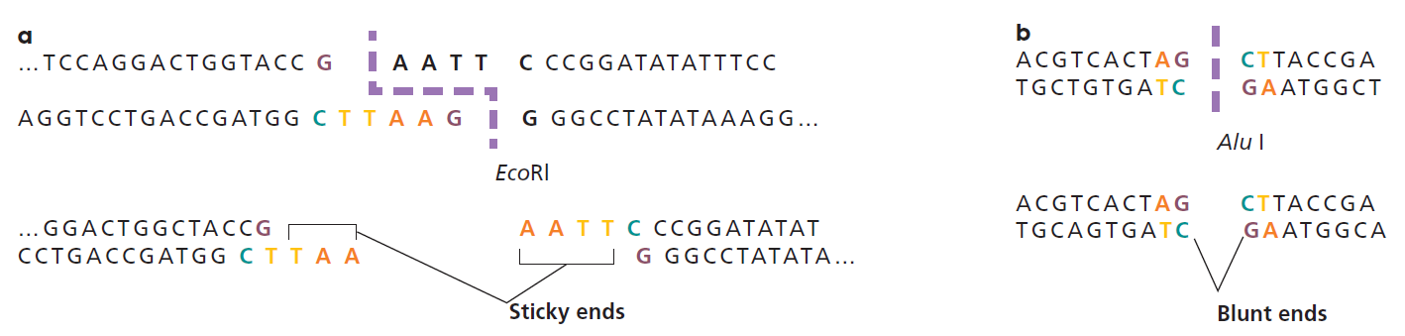
Cutting DNA
Genetic engineering techniques
Figure 5.2
Restriction enzymes can leave DNA with sticky ends (a above) or blunt ends (b above).
Sticky ends are easier to join in the correct orientation.

Slide 7
Joining DNA
Genetic engineering techniques
Ligases are enzymes that join (ligate) the sugar-phosphate backbones of DNA fragments.
A restriction fragment is often inserted into a vector (carrier) such as a bacterial plasmid so it can be easily copied in bacterial cells.
To increase the chances of the fragment inserting into the plasmid in the correct orientation, the plasmid can be cut with the same restriction enzymes to produce the same sticky ends.

Slide 8
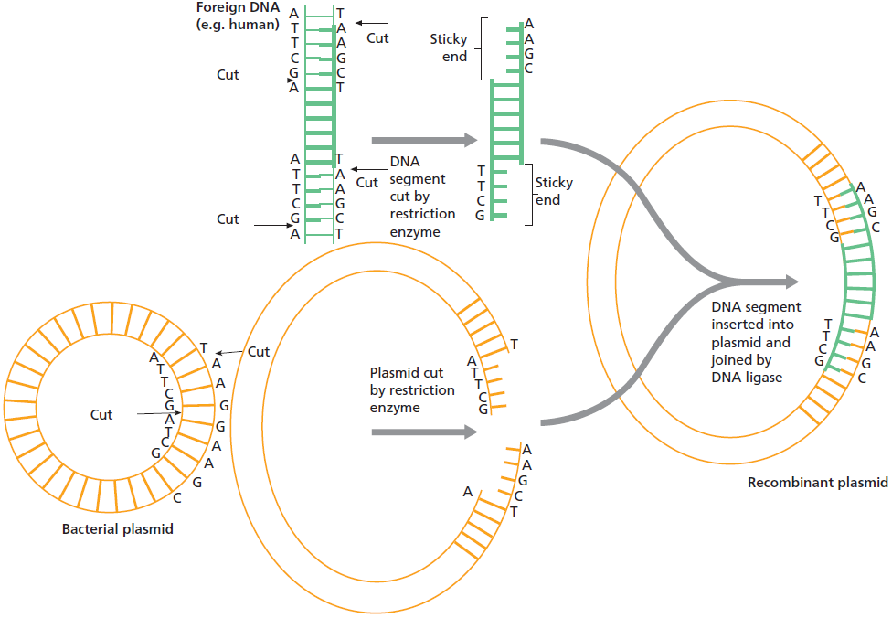
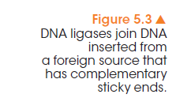

Slide 9
Copying DNA
Genetic engineering techniques
Recombinant plasmids can be put into bacterial cells (e.g. E. coli) and the bacteria grown in culture.
This produces many copies, or clones, of the plasmid.
The bacterial cells can be burst open, or lysed, and the plasmid DNA extracted for the next part of the process.
This is discussed in more detail later.

Slide 10
Copying DNA
Genetic engineering techniques
Another method of making many copies of a DNA fragment is by the polymerase chain reaction (PCR).
This is essentially DNA replication in vitro, or in a test tube. It uses free nucleotides, a template strand of DNA and DNA polymerase.
Other components include a buffer that produces the conditions for the polymerase to work effectively, and primers.
Primers are short (~20bp) single stranded DNA fragments that bind to the 5’ end of the template. They are necessary because DNA polymerase can only extend an existing strand of DNA.

Slide 11
Copying DNA
Genetic engineering techniques
The polymerase chain reaction (PCR) relies on cycles of temperature.
Firstly, without DNA helicase, the template and complementary strands are separated by denaturation at 95°C, separating the hydrogen bonds.
Next, the reaction is cooled to around 50-60°C, which allows the primers to anneal, or bind their complementary sequence.
The temperature depends on the nucleotide composition and length of the primers.
The reaction is cooled to 72°C, the optimal temperature for the DNA polymerase that’s used for PCR.
The DNA polymerase used is from a thermophile, Thermus aquaticus, a bacteria that lives in hot springs and can tolerate the 95°C melting temperature of PCR.
At the end of each cycle, the number of DNA fragments is doubled.

Slide 12
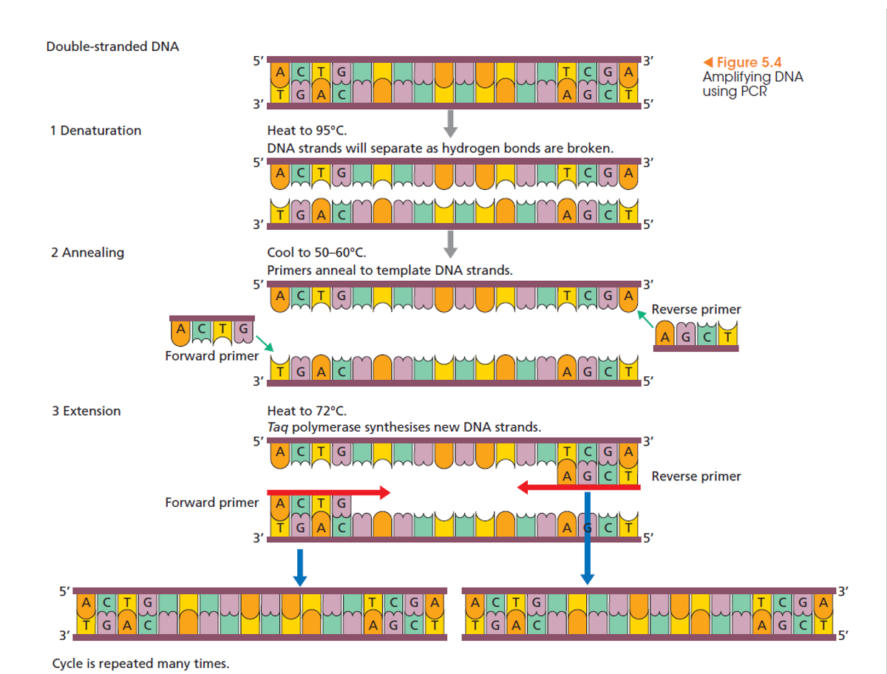

Slide 13
Visualising DNA
Genetic engineering techniques
How do we know that our restriction enzyme digestion of DNA has worked?
How do we know that a PCR reaction has worked?
How do we know that a DNA fragment has been incorporated into a plasmid?
DNA is clear in solution and it’s necessary to find a way to visualise it so we can answer these questions.
For this we use gel electrophoresis, which takes advantage of the negative charge of DNA that comes from its sugar-phosphate backbone.

Slide 14
Visualising DNA
Genetic engineering techniques
In gel electrophoresis, agarose is melted by heating, poured into a mould and cooled. It then forms a matrix, similar to a sponge, with microscopic holes.
At one end of the gel, wells are formed by the use of a comb as part of the mould. The DNA samples are loaded into the wells.
The gel is put in a chamber, filled with a buffer solution, and a current applied. The negatively charged DNA moves through the gel towards the positive electrode.
The larger pieces of DNA are held up within the gel and move more slowly than the smaller pieces of DNA.

Slide 15
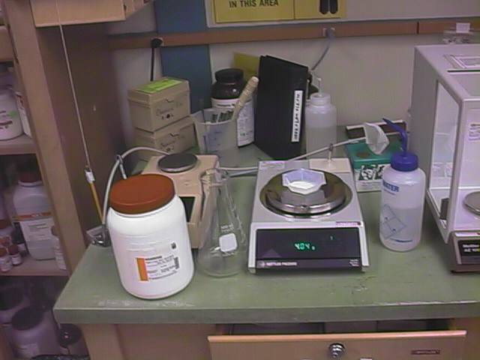
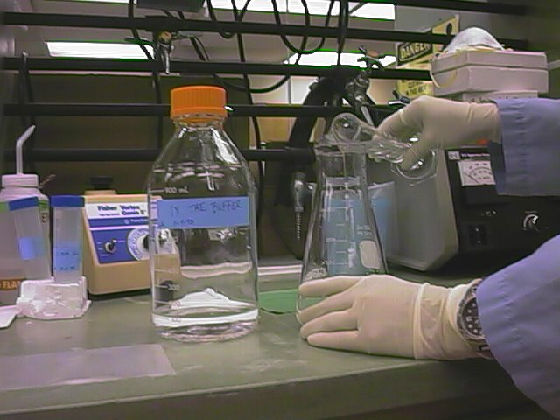
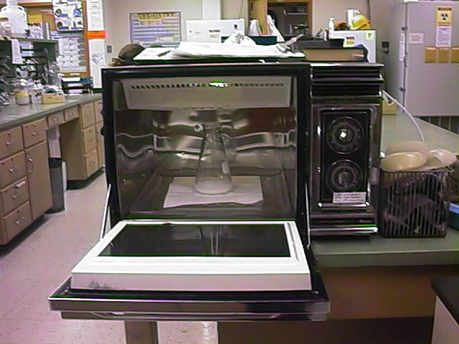
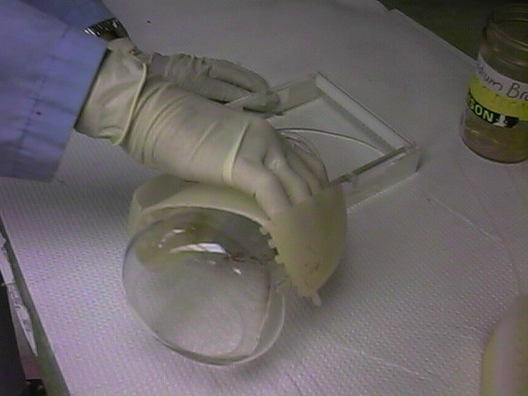
Genetic engineering techniques
1 Weighing out the agarose
2 Adding buffer to agarose
3 Melting the agarose solution
4 Pouring the agarose into a mould
Usually at this stage a DNA-binding dye is added to the gel.
http://hydrology1.nmsu.edu/Teaching_Material/SOIL698/electrophoresis/agarose.html

Slide 16
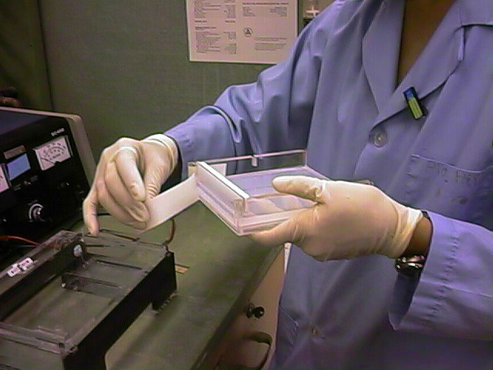
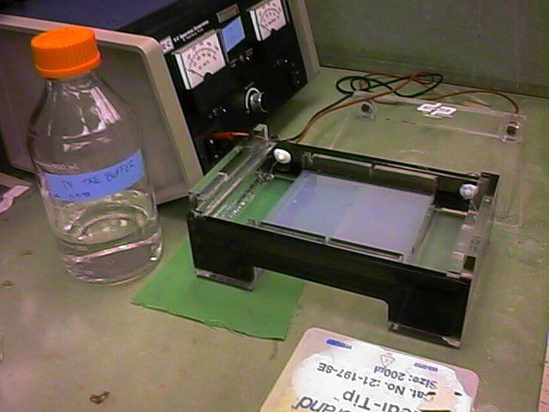
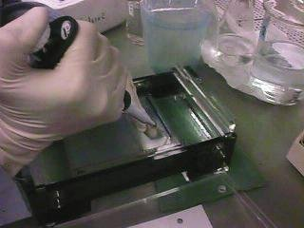
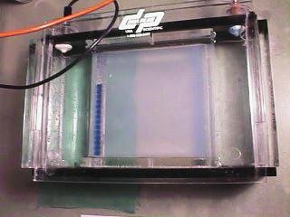
Genetic engineering techniques
5 Removing the set agarose gel
6 The gel is placed in a buffer-filled chamber
7 Loading DNA into the wells
8 A current is applied
Positive electrode
Negative
electrode

Slide 17
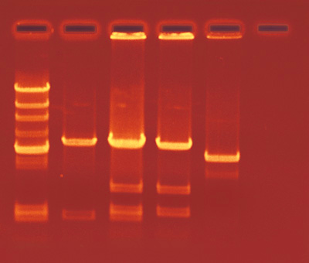
Genetic engineering techniques
Under UV light, the DNA-binding dye allows the DNA to be visible. Fragments appear as bands separated according to size.
Negative electrode
Longer DNA fragments
The lane on the left contains a DNA ladder, with DNA fragments of known sizes.
Direction of DNA migration
Shorter DNA fragments
Positive electrode
Image from http://www.connecticutvalleybiological.com/

Slide 18
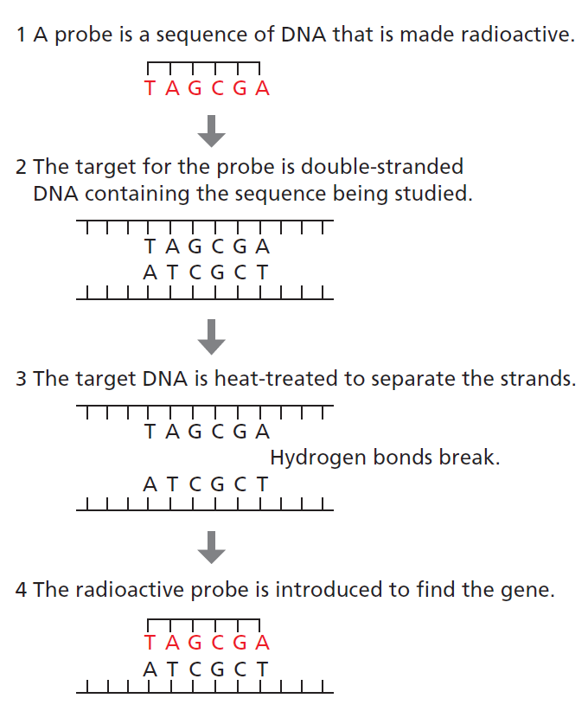
Searching for DNA sequences
Genetic engineering techniques
Gene probes can be used to search for a specific, small DNA sequence, such as the mutated allele that confers Huntington’s disease.
Figure 5.10
Notes:
(To look for a larger sequence you would perform PCR, using primers as probes)

Slide 19
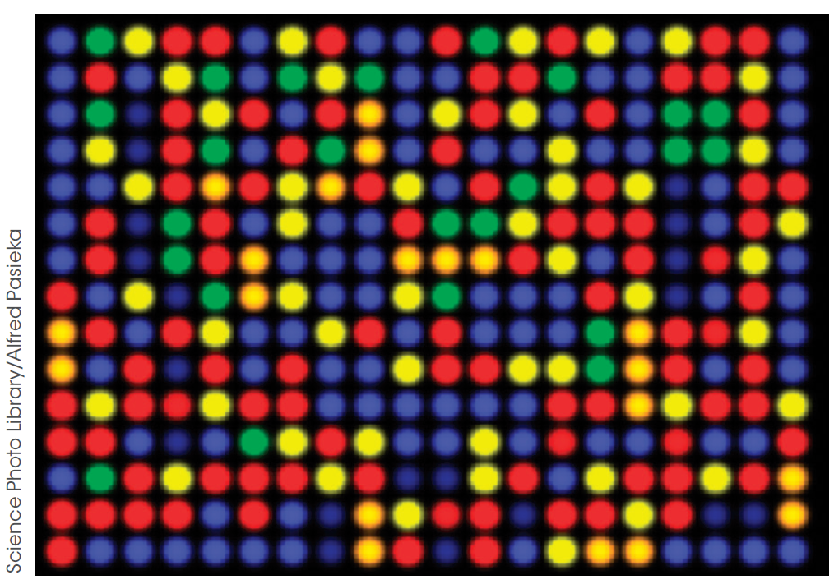
Searching for DNA sequences
Genetic engineering techniques
First a cell extract is made and mRNA is reverse transcribed to DNA (copy DNA, cDNA).
Many different probes can be fixed onto a glass plate and a sample of cDNA washed over them. This can show which mRNAs are present in the original sample.
This is the basis of microarrays.
In this figure, two cell extracts are washed over the plate. One sample’s cDNAs are labeled in red, the other in green.
Gene probes can be designed to detect mRNA. This shows whether a gene is expressed.
Figure 5.11
Notes:
Green dots mean that the sample labeled green expresses that mRNA. Red dots mean the mRNA is only expressed in the other sample. Yellow dots mean both samples express the mRNA and blue or black dots mean neither expresses it.

Slide 20
DNA sequencing
Genetic engineering techniques
Determining the sequence of DNA can be done on a small scale
(e.g. sequencing a plasmid to determine whether a fragment has been inserted in the correct orientation)
or on a large scale
(e.g. whole genomes).
The first human genome sequence was published in 2001 at a cost of $100 million.
New next-generation sequencing techniques can allow us to sequence a full human genome in only five days at a cost of $10 000.

Slide 21
Copying DNA using plasmids
Genetic engineering techniques
Plasmids make good DNA copiers because:
plasmids can incorporate foreign DNA
their small, circular nature gives them stability
plasmids can be copied within bacteria, which are easily grown in the lab
plasmids can replicate even when they contain foreign DNA
genes on plasmids can be expressed in bacteria.
    When these genes confer antibiotic resistance, they are called selection markers.
    Growing bacteria in antibiotic-containing media ensures only the cells containing the plasmids grow. This is the basis of antibiotic selection.

Slide 22
Copying DNA using plasmids
Genetic engineering techniques
Copying DNA using plasmids is called genetic cloning. The process involves the following steps.
Extracting plasmids from bacterial cells by rupturing (lysing) them
Cutting the plasmid with restriction enzymes
Cutting the DNA fragment to be inserted with the same restriction enzymes (to give the same sticky ends)
Incubating the cut fragment and plasmid together with DNA ligase
Inserting the plasmid into bacterial cells. This is called transformation.
Selecting transformed bacteria by growing them in antibiotic-containing media.

Slide 23
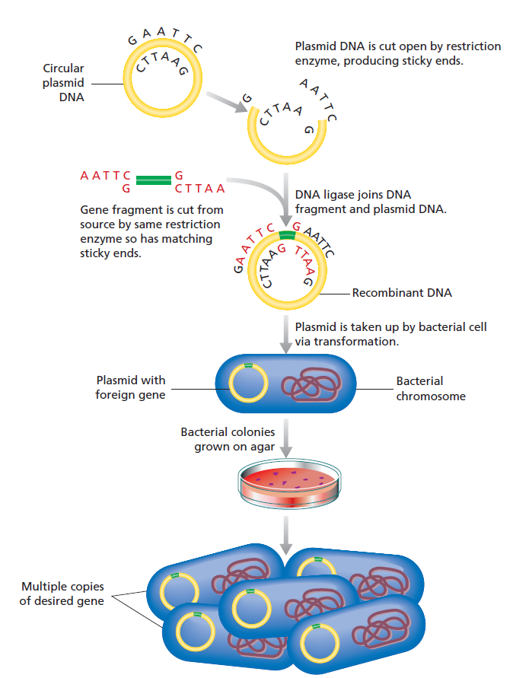
Figure 5.14

Slide 24
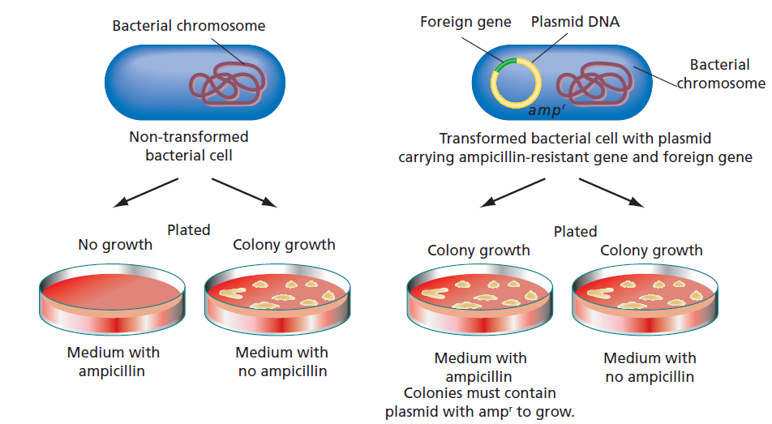
Antibiotic selection
Genetic engineering techniques
Figure 5.15

Slide 25
Transferring genes
Genetic engineering techniques
Recombinant gene technology can replace missing or impaired genes in diseases where single genes are affected.
To transfer genes into another organism, the genes need to be delivered in such a way that they can be active (expressed) in that organism.
Vectors are tools that can transport DNA from one organism to another.
Plasmids can be used as vectors, and viruses are useful natural vectors which can often accept large foreign DNA inserts.
Viruses already contain the machinery for replicating themselves and injecting DNA into cells.

Slide 26
DNA profiling
Genetic engineering techniques
DNA profiling examines short tandem repeats (STRs) and variable nucleotide tandem repeats (VNTRs) within an individual’s genome to determine how similar it is to another individual’s genome.
STRs contain repeats of a short (2-5bp) sequence; e.g. GAGAGAGA
VNTRs are repeats of more than 5 nucleotides; e.g. 17-40 bases:
…ACTGGTACCATAACAGTG..
11
18

Slide 27
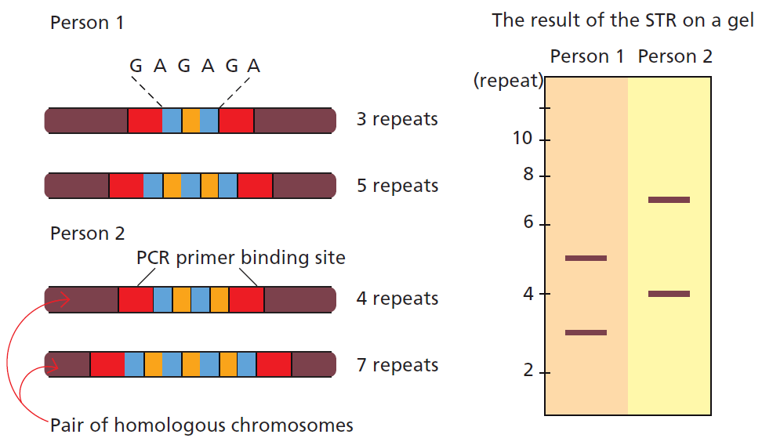
DNA profiling
Genetic engineering techniques
DNA profiling is carried out by isolation of DNA from cells (e.g. cheek cells), PCR amplification of the region containing the repeats, then gel electrophoresis to examine the size of bands.
Figure 5.17

Slide 28
Applications for health
Biotechnology applications
Identification of alleles responsible for genetic diseases can be informative in the quest to find a cure or treatment
    This can also help in the development of a screen for a disease
Transgenic organisms can be made to produce large quantities of proteins for therapeutic purposes; e.g. insulin, haemoglobin and blood clotting factor VIII
Gene therapy can be used to provide a functional gene in the case of a genetic disease.

Slide 29
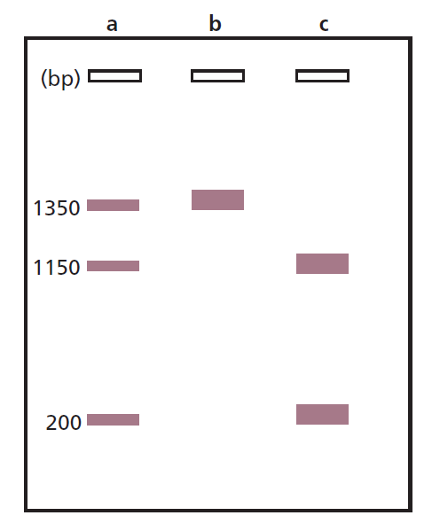
Genetic testing
Biotechnology applications
A mutation that confers disease can be detected by sequencing or, if it changes a restriction site, by restriction fragment length polymorphism (RFLP) analysis.
Sickle cell anaemia is due to a point mutation in the beta-globin gene. This mutation deletes a MstII restriction site, causing loss of one of three restriction sites in the allele.
a – carrier
b – a person with sickle cell anaemia
c – a normal individual
Figure 5.21

Slide 30
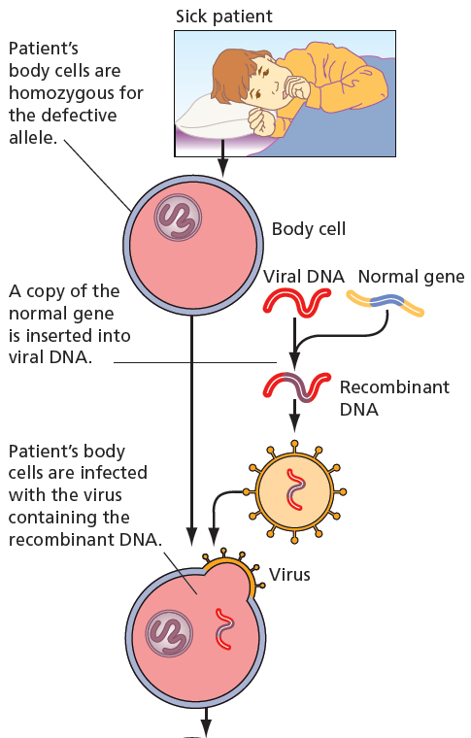
Gene therapy
Biotechnology applications
Gene therapy has been used to treat children with severe combined immunodeficiency syndrome (SCID).
An adenovirus carrying the functional DNA was incubated with the patient’s body cells, which allowed the functional DNA to be inserted into the patient’s chromosome.
Figure 5.22

Slide 31
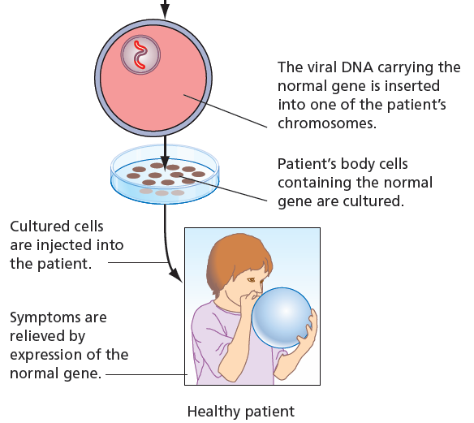
Gene therapy
Biotechnology applications
The recombinant body cells were injected back into the patient and restored the function that was missing, relieving symptoms.
Figure 5.22 (continued)

Slide 32
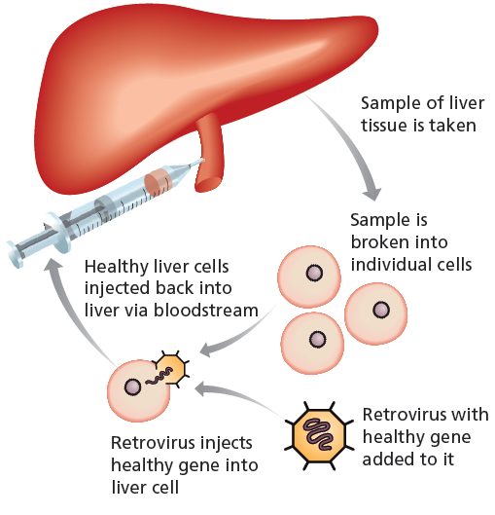
Gene therapy
Biotechnology applications
Figure 5.23
Gene therapy is still being refined in the laboratory to try to improve efficiency.
When gene therapy targets somatic body cells, it is called somatic cell gene therapy.
Germline gene therapy transforms egg or sperm and is extremely controversial as it affects subsequent generations.

Slide 33
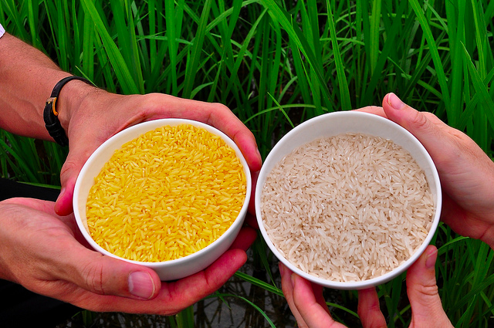
Agriculture
Biotechnology applications
Genes for nutrition
Golden rice contains the gene for beta-carotene, a precursor for vitamin A.
International Rice Research Institute

Slide 34
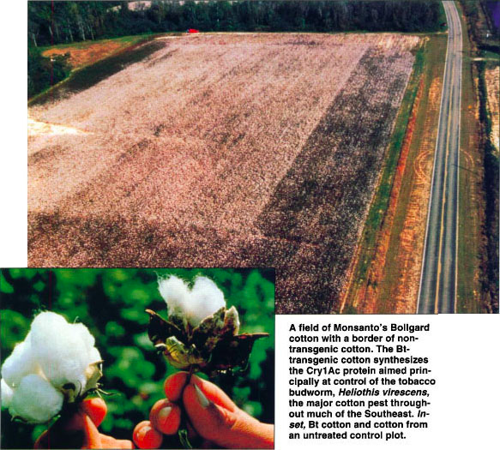
Agriculture
Biotechnology applications
Genes for pest resistance
Bt cotton contains genes from the soil bacterium Bacillus thuringiensis, which are toxic to the common cotton pathogen, the Heliothis caterpillar.
California Agriculture 52(6):14-20. DOI: 10.3733/ca.v052n06p14.

Slide 35
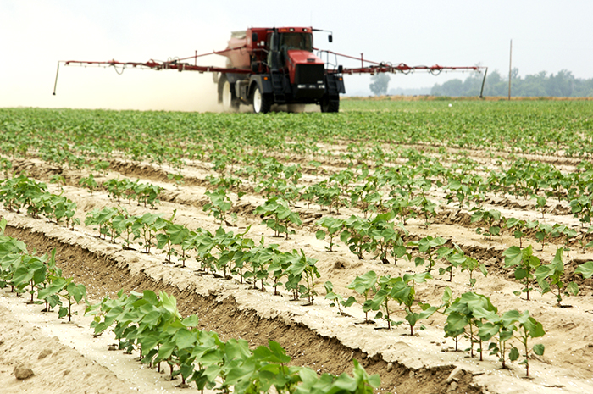
Agriculture
Biotechnology applications
Genes for herbicide resistance
The use of crops with genes for herbicide resistance, such as Monsanto’s Roundup Ready crops, allows widespread glyphosate herbicide spraying.
http://www.aganytime.com/deltapine/protection/Pages/Weed-Management.aspx

Slide 36
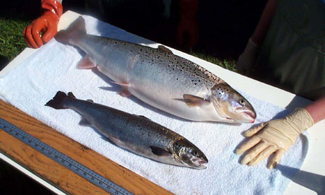
Agriculture
Biotechnology applications
http://www.theguardian.com/environment/2011/sep/12/congress-gm-salmon
Genetically engineered animals
Examples include salmon with faster growth rates, cows that produce milk similar to human breast milk and Enviropigs, which release less phosphorous.
Many strains of genetically engineered lab animals (mainly mice) allow major research advances.

Slide 37

Biodiversity
Biotechnology applications
Figure 5.25
Genetic testing can measure the degree of genetic diversity in a population.
Genetic testing can also inform selective breeding strategies to maintain heterozygosity and genetic diversity.

Slide 38
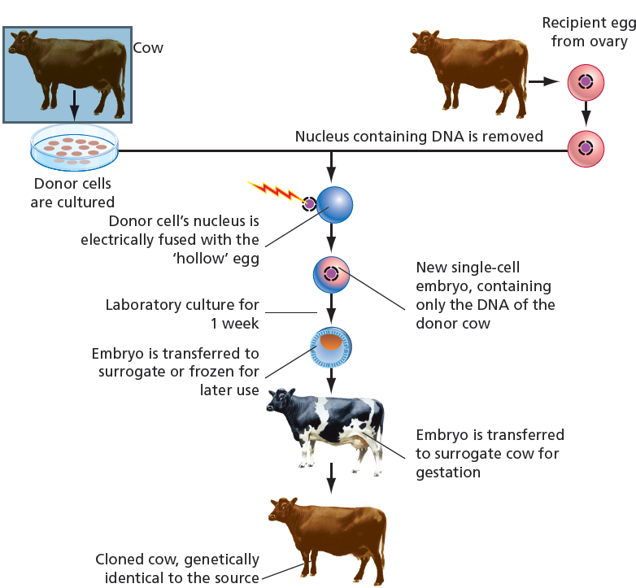
Cloning
Emerging technologies
Cloning involves making an identical copy of an organism
(with the same DNA sequence).
It can be achieved by embryo splitting or by nuclear transfer.
In nuclear transfer, a nucleus from a donor somatic cell is fused into a recipient cell whose own nucleus has been removed. This was how Dolly the sheep was created.
Figure 5.26

Slide 39
Stem cell research
Emerging technologies
Stem cells are cells that have not differentiated to become specialised, but instead are able to become many different types of cell.
Stem cells can be
pluripotent – they can become virtually any type of cell in the body
or
multipotent – they can give rise to a more limited range of cell types.
In the lab, somatic cells can be altered to become induced pluripotent stem cells by trying to reverse their differentiation, although this approach still requires much research.

Slide 40
Ethical questions
Ethics of biotechnology
When considering the implications of gene technology, we should ask:
Is the effect on the organism temporary or permanent?
Is the change heritable?
Is the structure or function of an organism changed?
Is the health or survival of non-target specifies affected?
Does the change give an organism an advantage over non-modified organisms?

Slide 41
GMOs
Ethics of biotechnology
There is a great deal of debate over the use of GMOs. Several ethical considerations should be made. These include:
How does the modification affect the organism?
How does the modification affect the ecosystem?
How does the modification affect consumers?

Slide 42
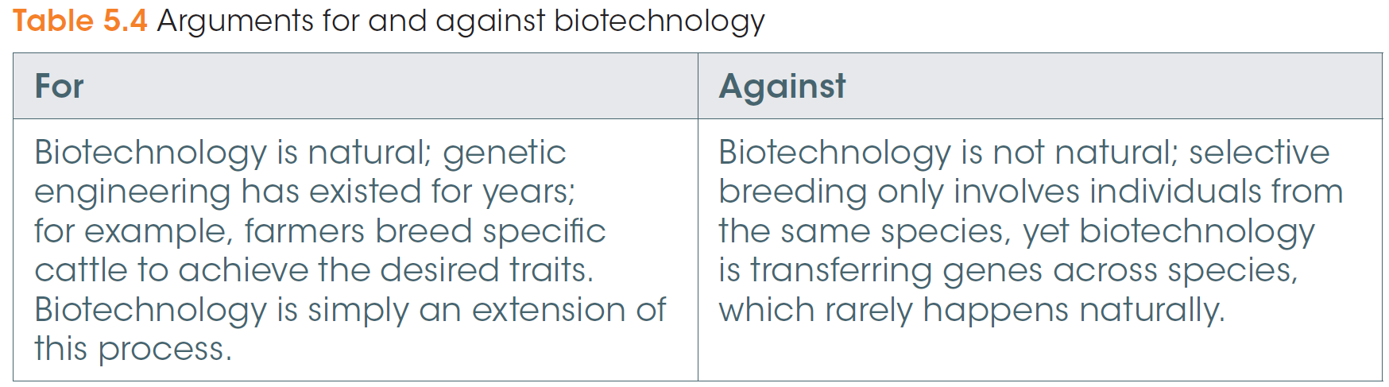
Ethical arguments for and against biotechnology
Ethics of biotechnology

Slide 43
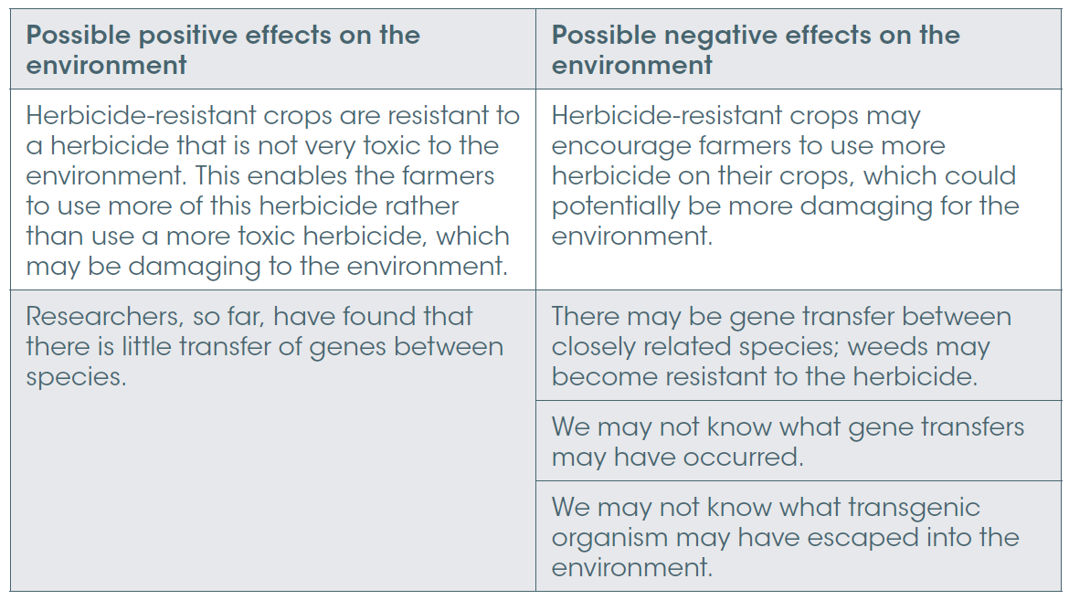
Ethical arguments for and against biotechnology - environment
Ethics of biotechnology
Table 5.5

Slide 44
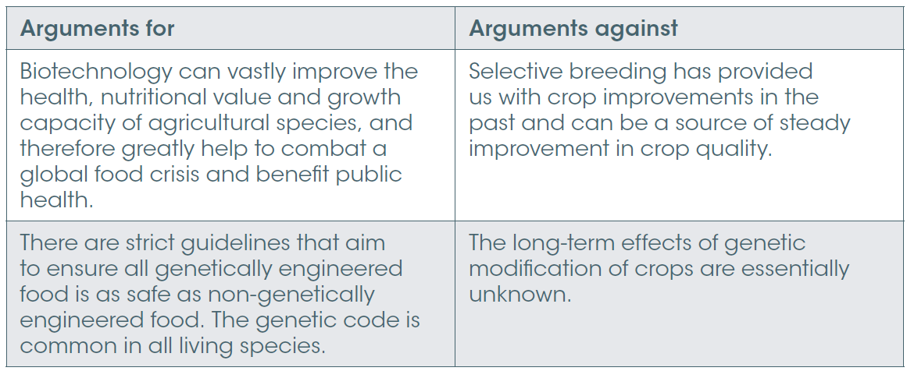
Ethical arguments for and against biotechnology – public health
Ethics of biotechnology
Table 5.6

Slide 45
Issues in medicine
Ethics of biotechnology
It’s difficult to know how genomics will affect society. Who should have access to your genetic information? For example, if you are a carrier of a disease allele, should your family members know? What about your health insurance company?
Patenting genes (that is, owning the exclusive rights to use the gene for therapeutic strategies) was allowed until July 2013 when a US court ruled that genes could not be patented.
Patenting is a common practice when a scientific discovery is made. It provides financial incentive for a company to develop the discovery for use, because it eliminates competition for a time period.

Slide 46
Animal ethics
Ethics of biotechnology
The use of animals for research can provide essential insights into how a gene or protein functions, or whether a drug will be safe and effective in humans.
No new drugs can be used in humans without pre-clinical animal studies.
Ethical considerations over the use of animals for research focus on animal welfare.
Animal use for research in Australia is governed by strong ethical principals and strict conditions that are continuously policed and reviewed.

